Slide 1
Text based game idea presentation
By Ajil Pappachan
L4 GDV

Slide 2
Millionaire
Idea 1

Slide 3
Overview
Based on the TV Game Show "Who Wants to be a Millionaire"
Objective is to get as many points as possible by answering multiple choice questions

Slide 4
RULes
Total of 15 Questions
Each question harder than the last but also carries more points
Player Loses the game if he/she answers a question wrong
Player Wins the game if he/she answers 15 questions correctly
If a player is unable to win, he may set a high score that he or another player may beat

Slide 5
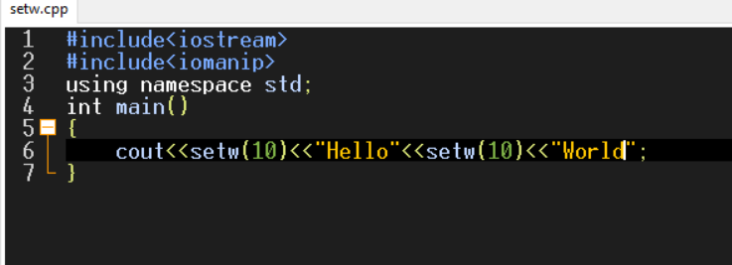
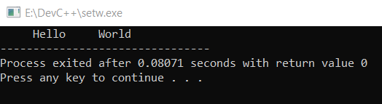
Gameplay mechanics
Text is Printed on Screen using functions like gotoxy(),setw(),etc to print in an attractive way

Slide 6
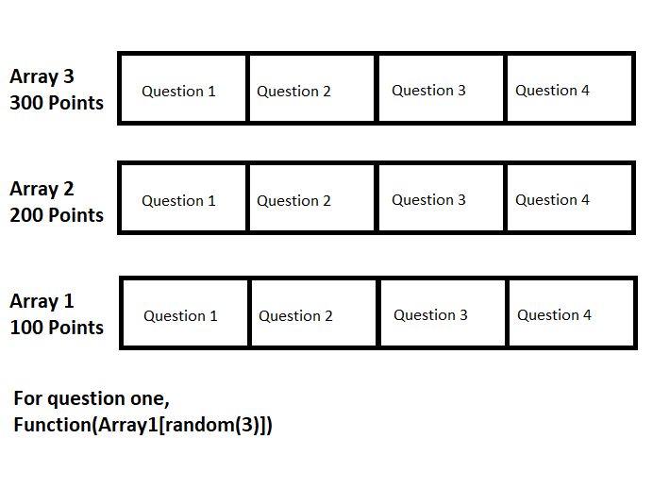
Gameplay mechanics
Questions are generated randomly using a function to print an element from an array of text elements

Slide 7
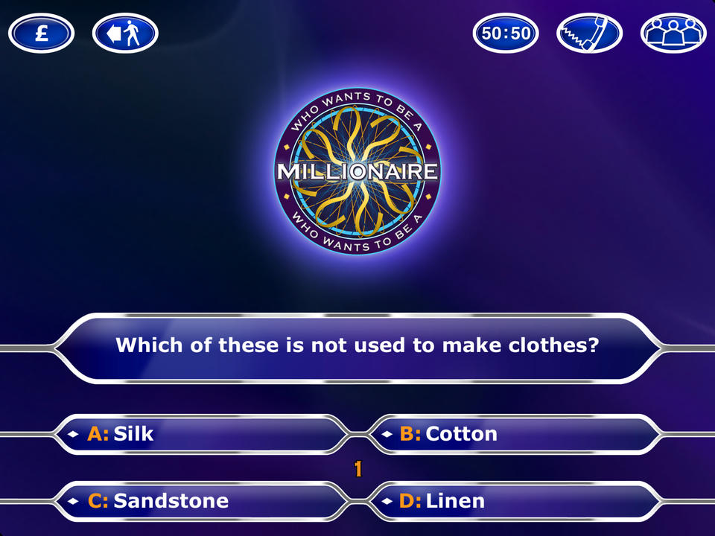
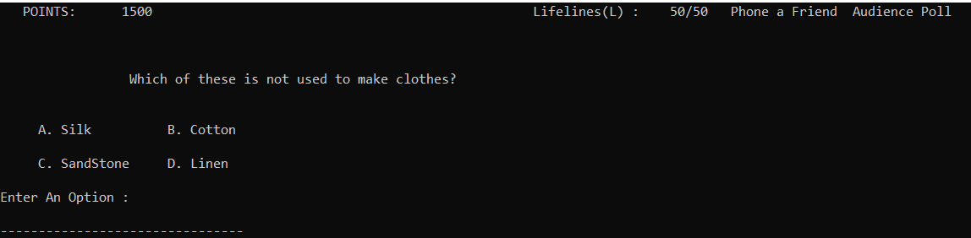
Gameplay mechanics
Example Screen
Image of TV Show
Image of Game

Slide 8
Questions?

Slide 9
hangman
Idea 2

Slide 10
overview
Based on the Sketch and Paper Game of the same name
Objective is to guess the name of a country, one letter at a time
If the Player guesses a letter 5 times, he loses the game

Slide 11
rules
Player has to guess the name of the country, one letter at a time
Every time a player guesses wrong, his/her avatar moves one step closer to being executed
Player can make 5 mistakes before being hanged
If the player can guess the word before being hanged, he/she wins the game

Slide 12
Gameplay mechanics
A country name is generated randomly from a structure which contains character arrays that contain Country names
When the player enters a letter, the program checks if that letter is in the country name using loops.
If the letter does not exist in the name, a mistake point is awarded and the character is one step closer to being executed

Slide 13
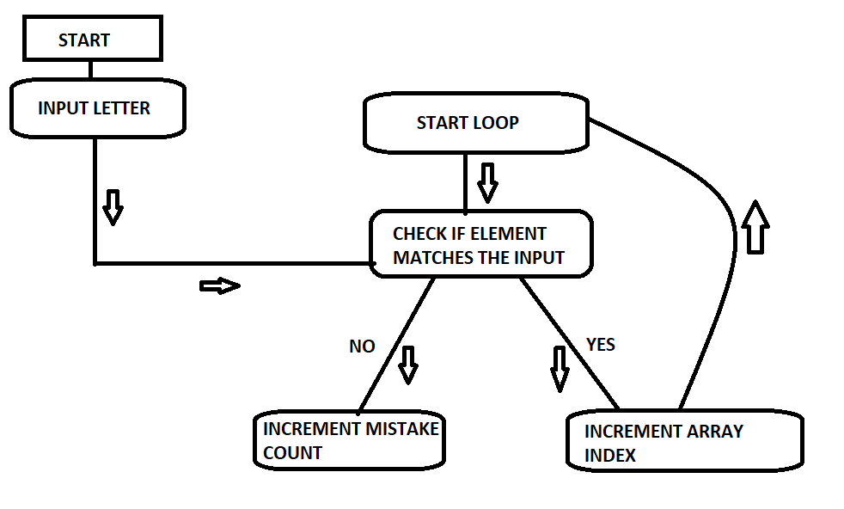
LOOP LOGIC

Slide 14
QUESTIONS?

Slide 15
Freshers' day
Idea 3

Slide 16
overview
Story-Driven Gameplay
Inspired by the famous text based game "Hitchhiker's Guide to the Galaxy"
Objective is to gain the trust and appreciation of fellow Classmates and Teachers

Slide 17
Narrative
The story takes place on the first day of college
Player meets new people, and attends classes
Classmates and Teachers form an opinion of the Player based on the Player's interactions with them and the performance in class tests
Story ends at the end of the day, when class is dismissed

Slide 18
Gameplay mechanics
Variables are used to store the current "Appreciation value" for each character in the game
Switch...Case is used to offer multiple ways for the player to interact with a certain character or deal with a specific situation
Class tests are Performed through implementing Logical and Mathematical Operators (Eg: To solve math Problems)
Performance in the Class tests also affect the Appreciation Value of certain characters (Especially Teachers)
Final Score Determined by considering the Appreciation values of every characters at the end of the day

Slide 19
Questions?

Slide 20
The end
Thank You!

